Slide 1
RETRONAS GAS STATION
INVENTORY APPLICATION
DURRANI AFIQ BIN SAIDIN 2020769853
MUHAMMAD KHAIRUDDIN BIN MOHD ZULKIFLI 2020938421
MUHAMMAD AIMAN BIN BAHARI 2019418168

Slide 2
INTRODUCTION

Slide 3
OBJECTIVES
Retronas Berhad is a petrol startup company that has just opened a new branch in Tapah Road. The gas station management has requested for a cashierless system to be developed to automate their business process. The gas station management also wishes to get more accurate data of their overall sales. With this data, it will help the manager to keep track of the sales data. This system will be written in Java.

Slide 4
FUNCTIONALITIES
Customer side:
> Display the available petrol dispenser, type of petrol and their prices.
> Enter request information and payment method.
> Calculate & display total fuel volume & cost.
> Store sales information and print receipt.
Manager side:
> Display sales summary.
> View weekly and monthly sales.
> View all the logged sales/requests.
> Search/Filter/Sort the list of the logged sales/requests.
Petrol request requirements:
> A minimum of 2.00 Litres of petrol is required for a valid purchase.

Slide 5
DESIGN

Slide 6
USE CASE
CUSTOMER
Select Pump Station
V
Select Fuel Type
V
Enter Payment Amount V
Select Payment Method
V
Make Payment
V
Starts Fueling
EMPLOYEE
(MANAGER)
Log In
V
View Sales Summary
V
View Logged Requests List
V
Search/Filter/Sort The Requests List

Slide 7
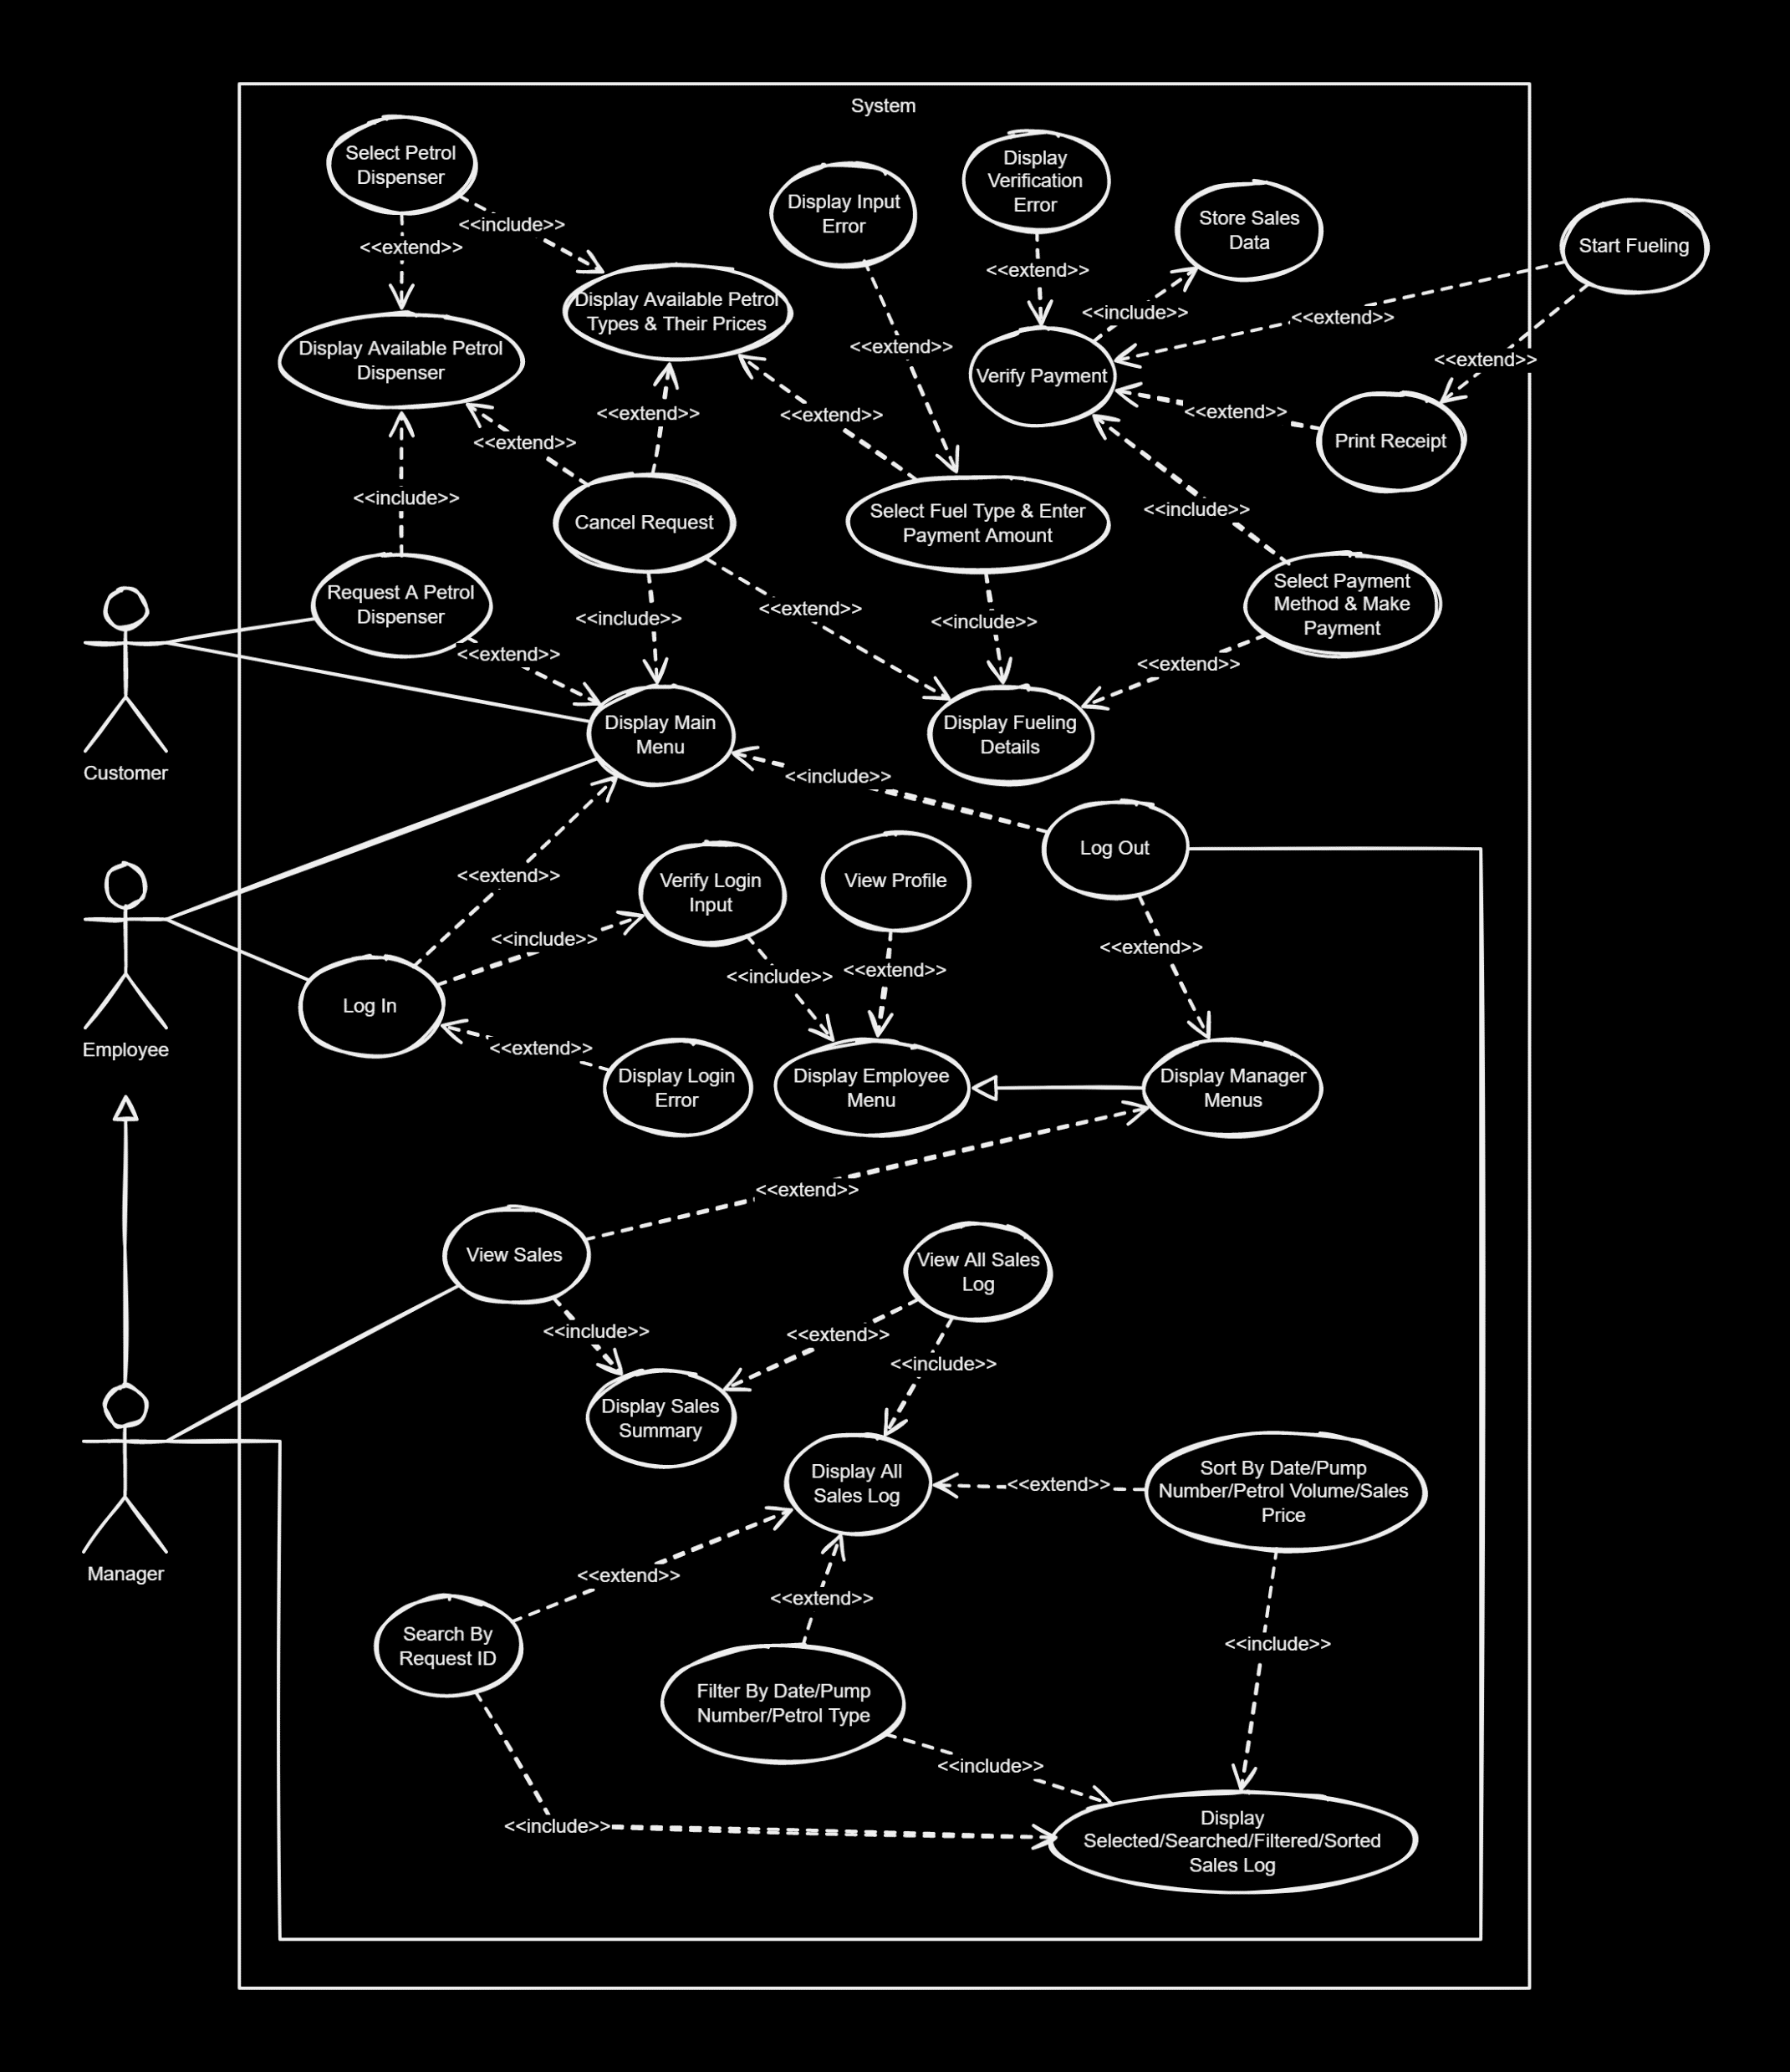
USE CASE
DIAGRAM

Slide 8
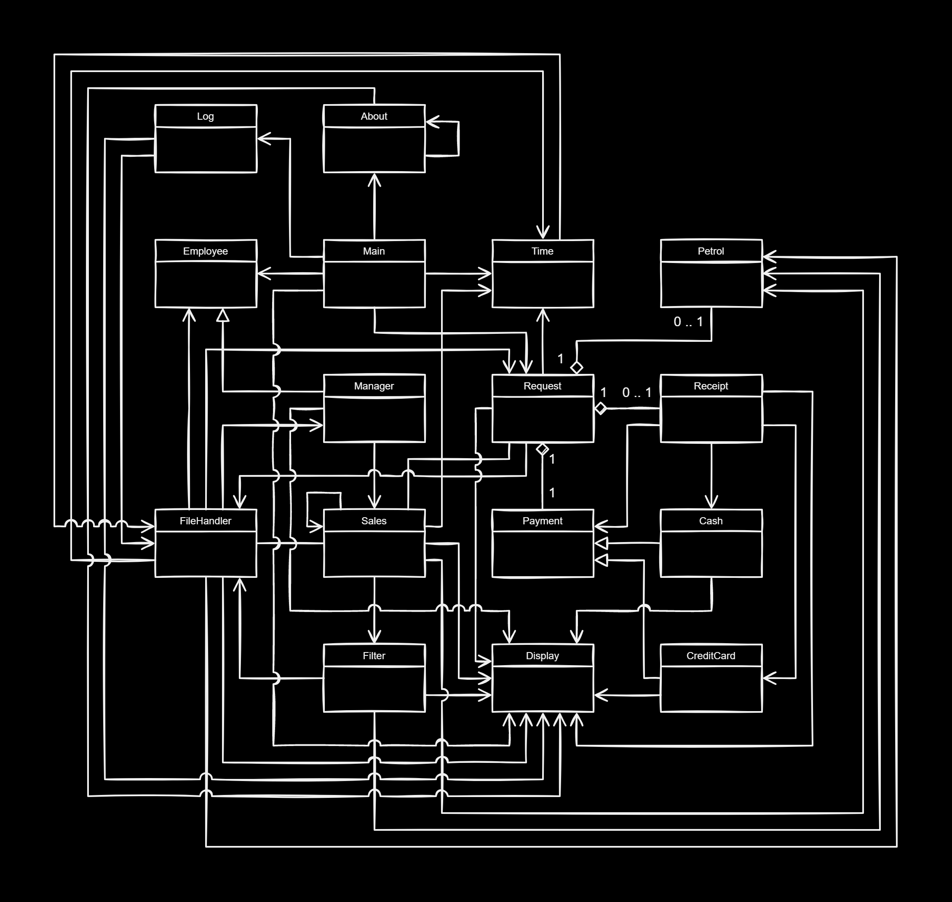
CLASS
DIAGRAM

Slide 9
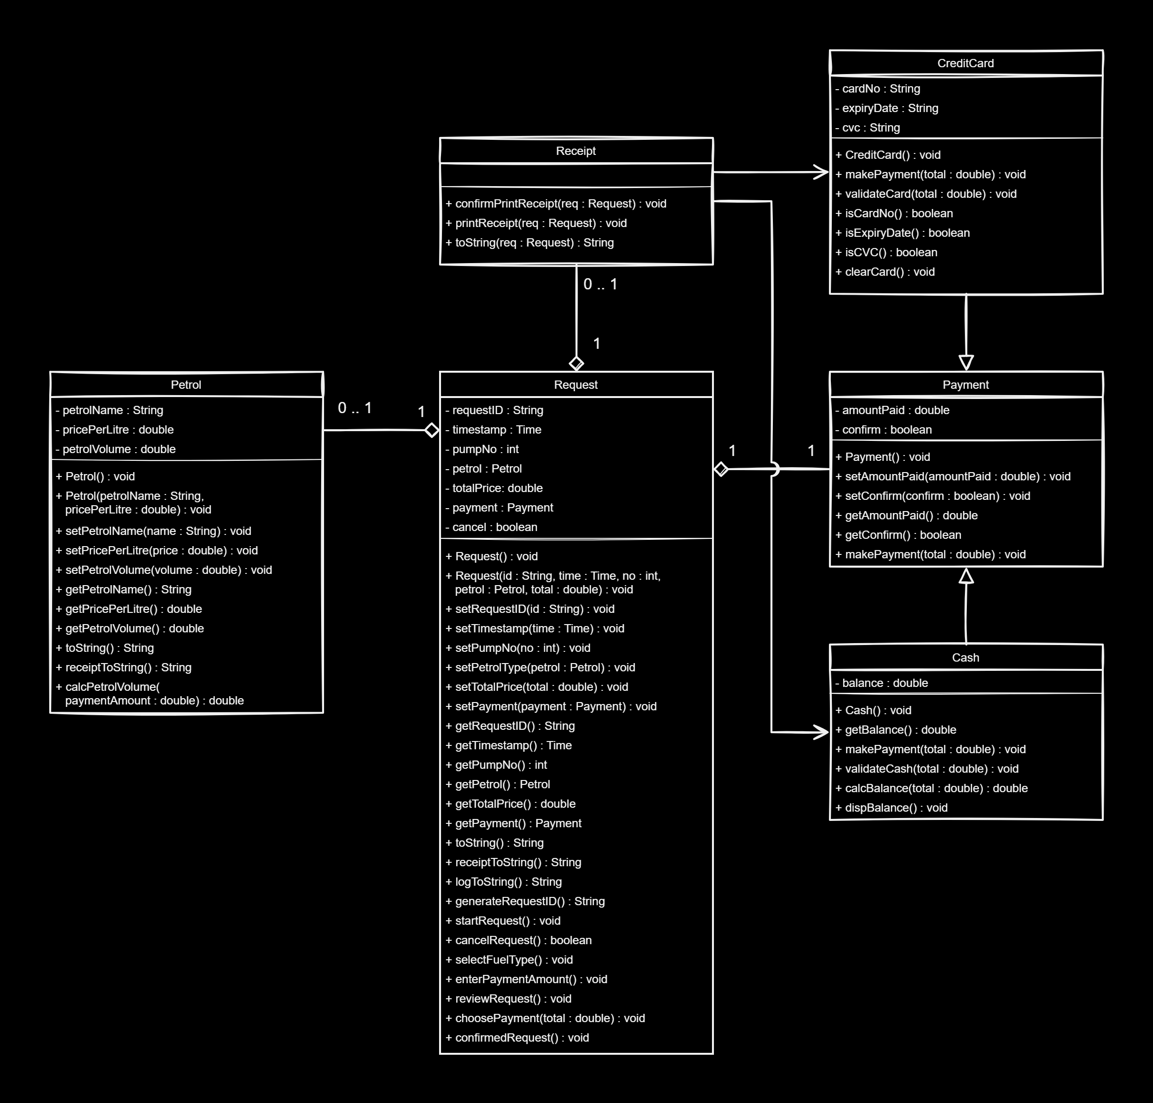
CLASS
DIAGRAM

Slide 10
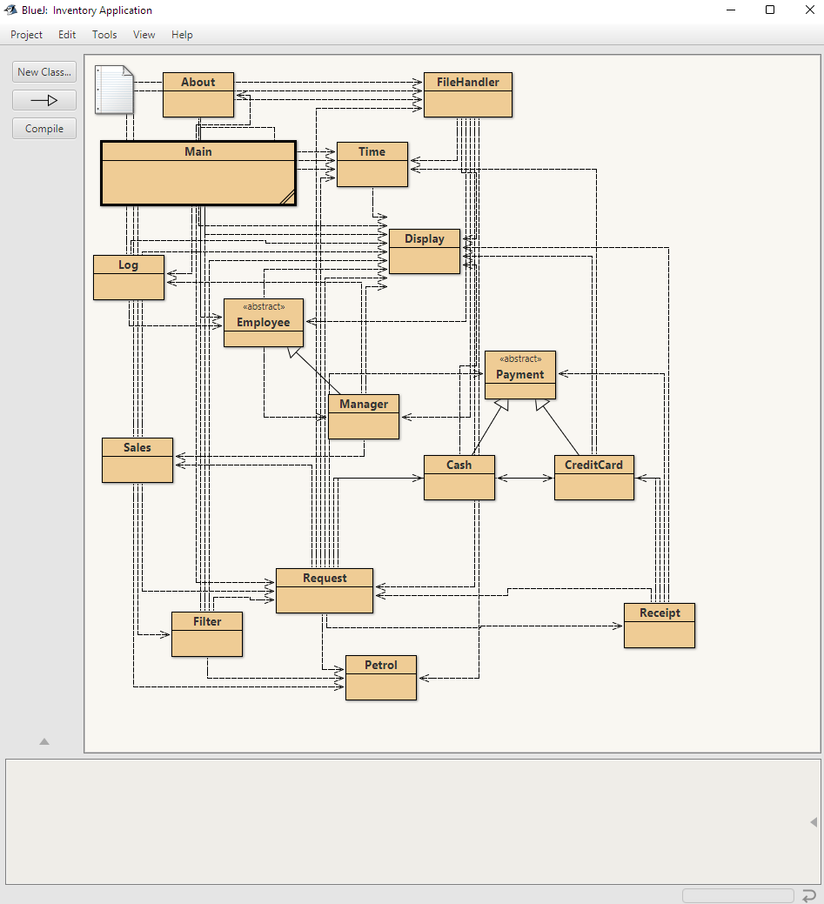
CLASS
DIAGRAM

Slide 11
IMPLEMENTATION
&&
CLASSES

Slide 12
Abstract
Data
Type
For this application, we decided to choose ArrayList as our ADT because it provides constant time for accessing and searching of request and employee elements at different indexes. Even for a new data insertion, they are inserted at the end of the array without having to shift the elements.

Slide 13
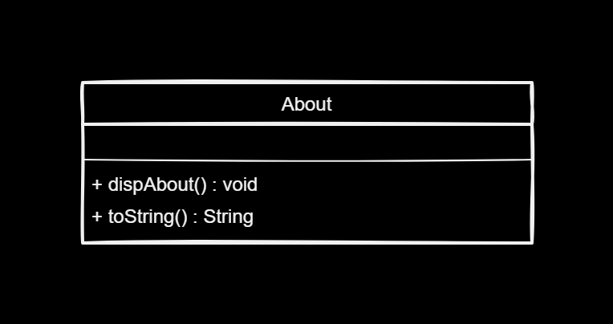
About
CLASS
> Display the about section (Credits)

Slide 14
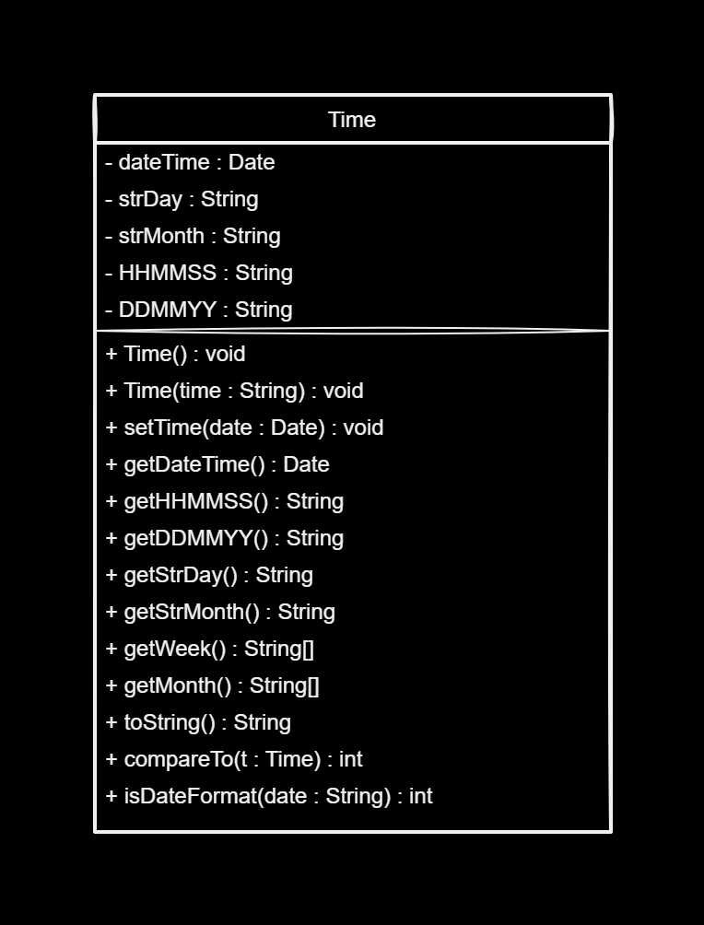
Time
CLASS
> Contain methods that has to do with date and time

Slide 15
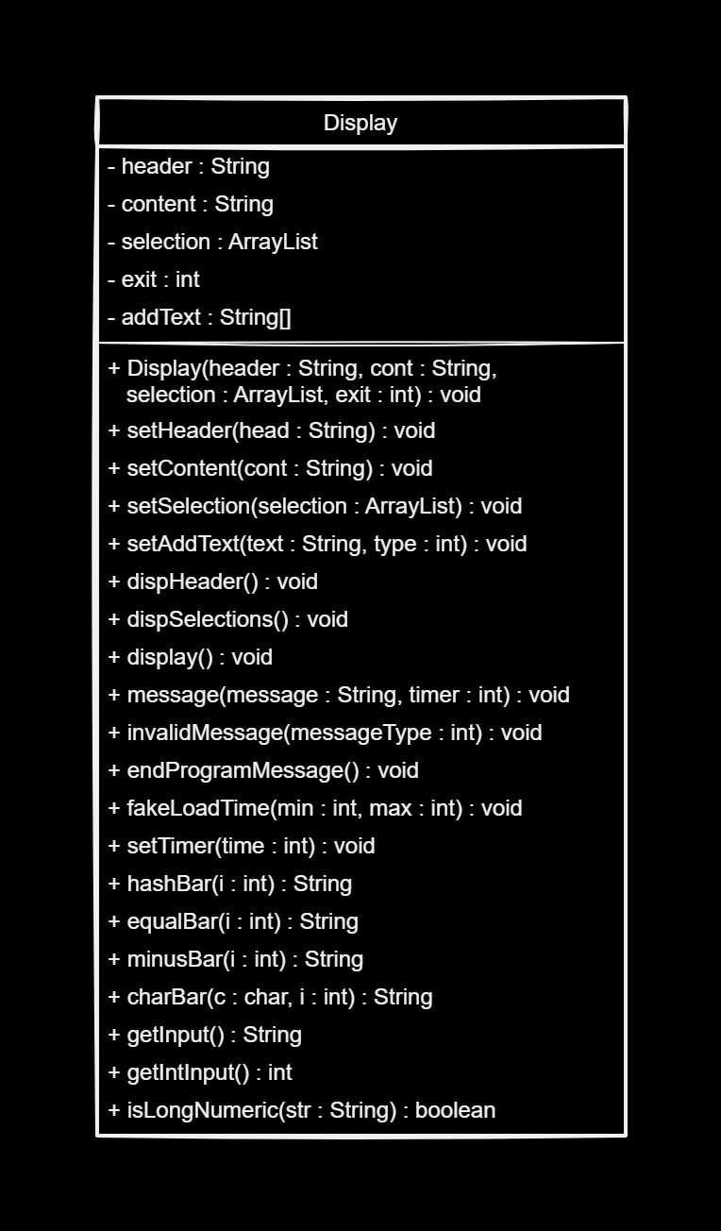
Display
CLASS
> Contain methods that helps with displaying the GUI in the terminal

Slide 16
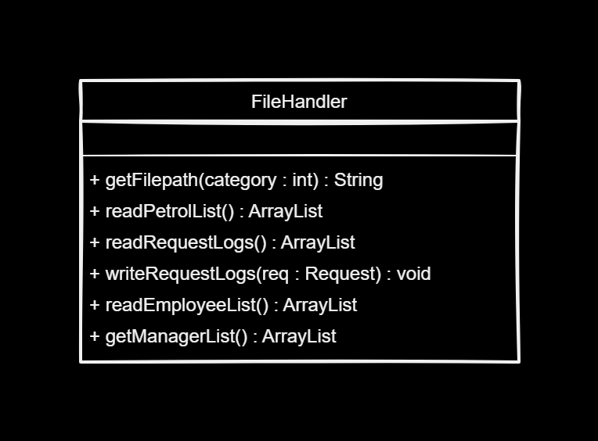
FileHandler
CLASS
> Handles file reading & writing

Slide 17
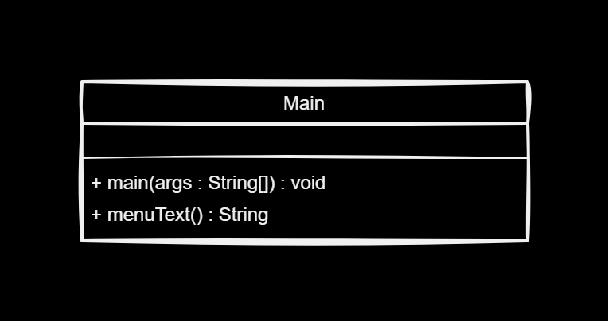
Main
CLASS
> Where the program begins its execution
> Displays the main menu

Slide 18
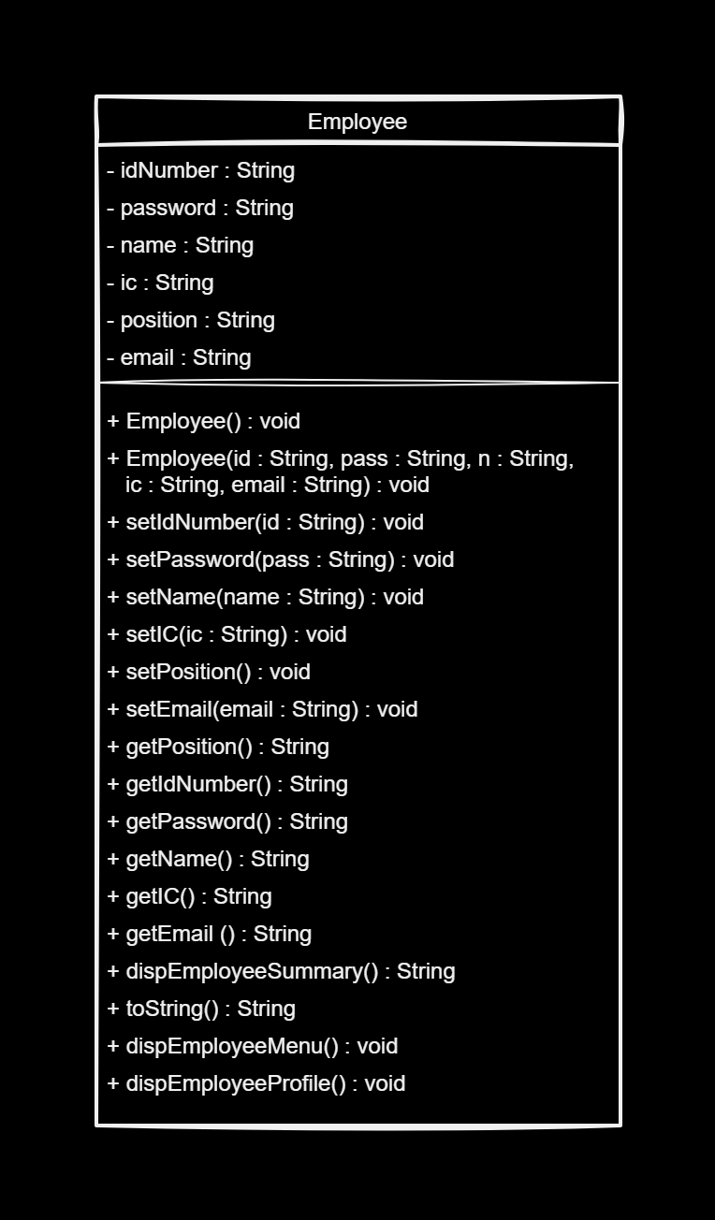
Employee
CLASS
> An abstract class
> Contain the attributes for the employee

Slide 19
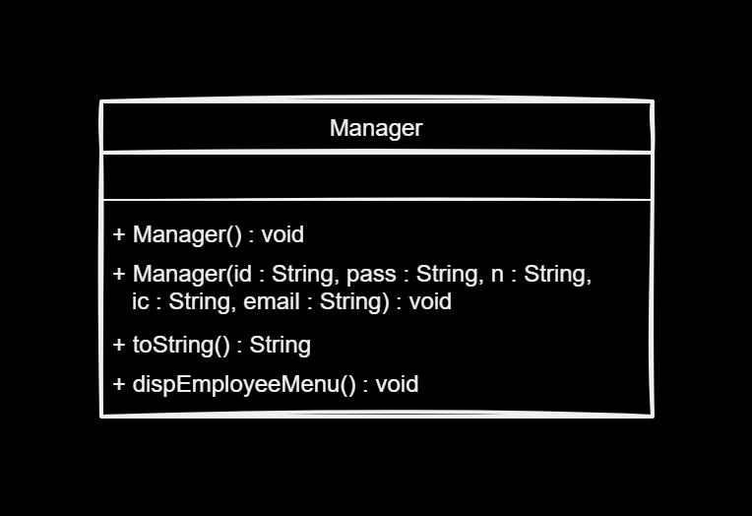
Manager
CLASS
> Inherits the Employee Class
> Displays the Manager menu

Slide 20
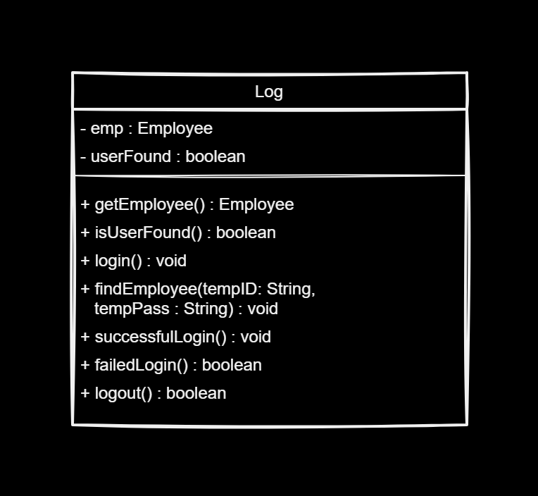
Log
CLASS
> Display & handles the employee login & logout process

Slide 21
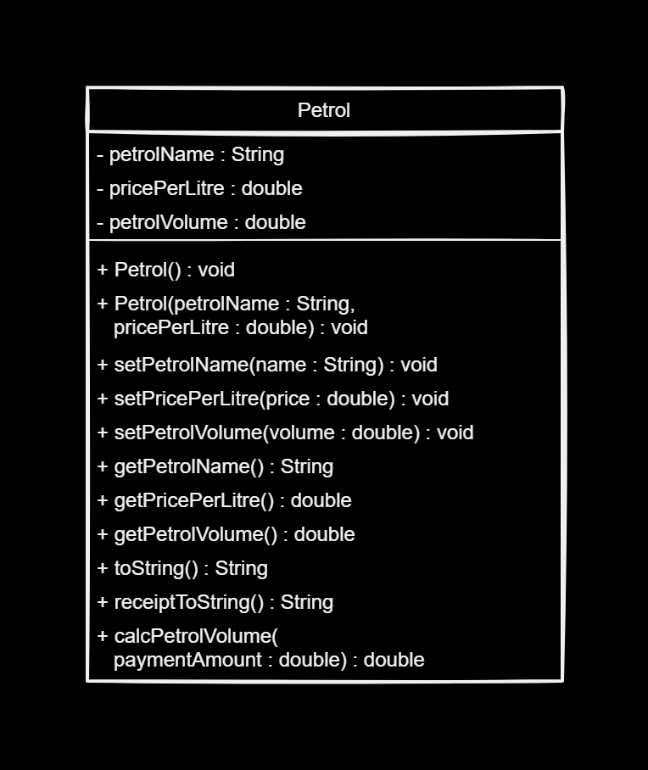
Petrol
CLASS
> Contain the attributes for the petrol
> Calculate the volume of petrol from the price input

Slide 22
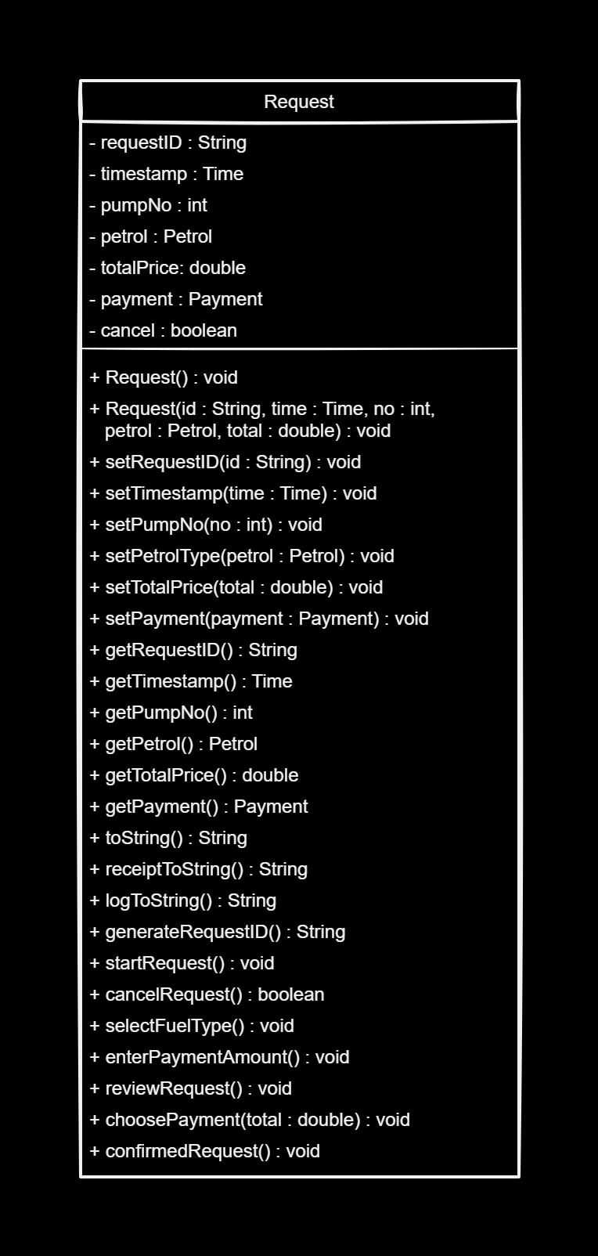
Request
CLASS
> Contain the attributes for the request information
> Display the customer-side menus for customer inputs
> Displays the available pump and fuel types
> Process and displays the request information

Slide 23
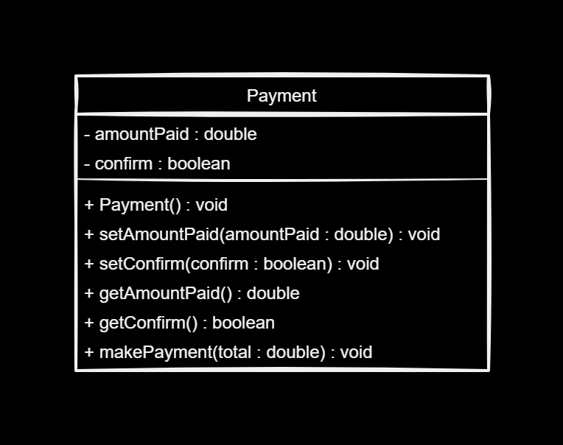
Payment
CLASS
> An abstract class
> Contain the payment attributes and information
> Process the payment details

Slide 24
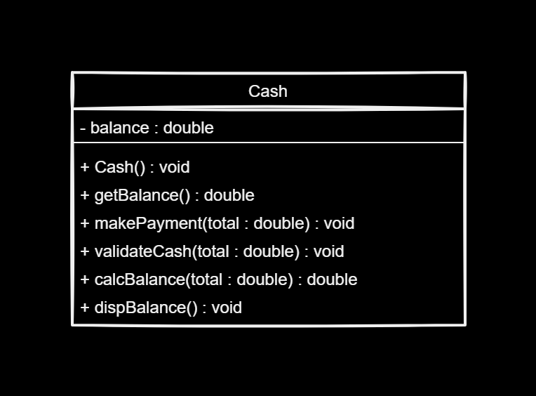
Cash
CLASS
> Inherits the Payment Class
> Processes the cash payment method

Slide 25
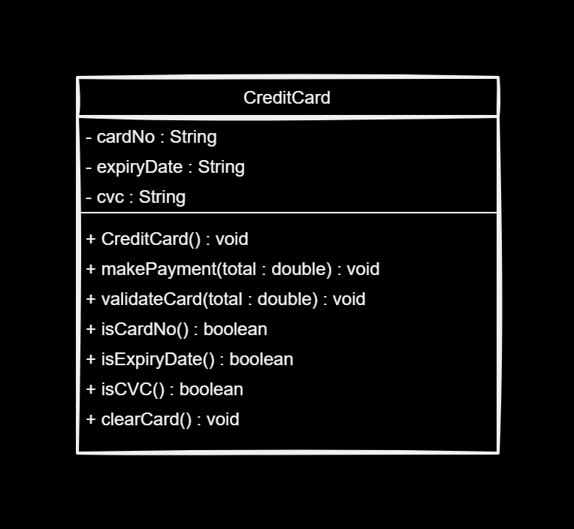
CreditCard
CLASS
> Inherits the Payment Class
> Contains the Credit Card information
> Process the Credit Card payment method

Slide 26
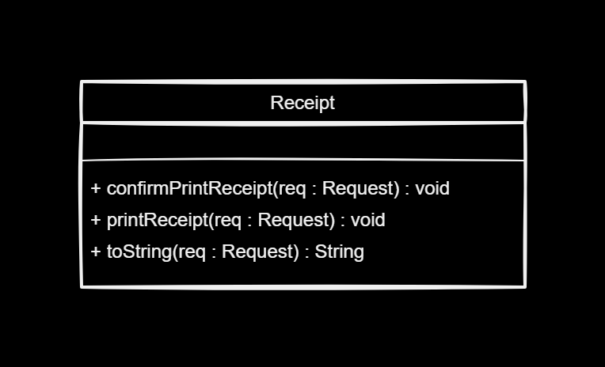
Receipt
CLASS
> Prints the receipt

Slide 27
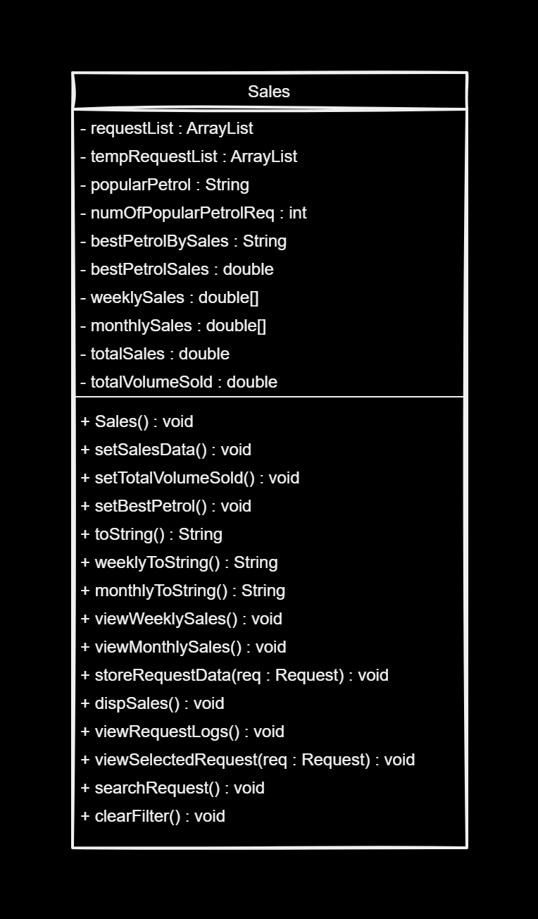
Sales
CLASS
> Contain all the sales attributes and information
> Process & display the sales or logged requests information

Slide 28
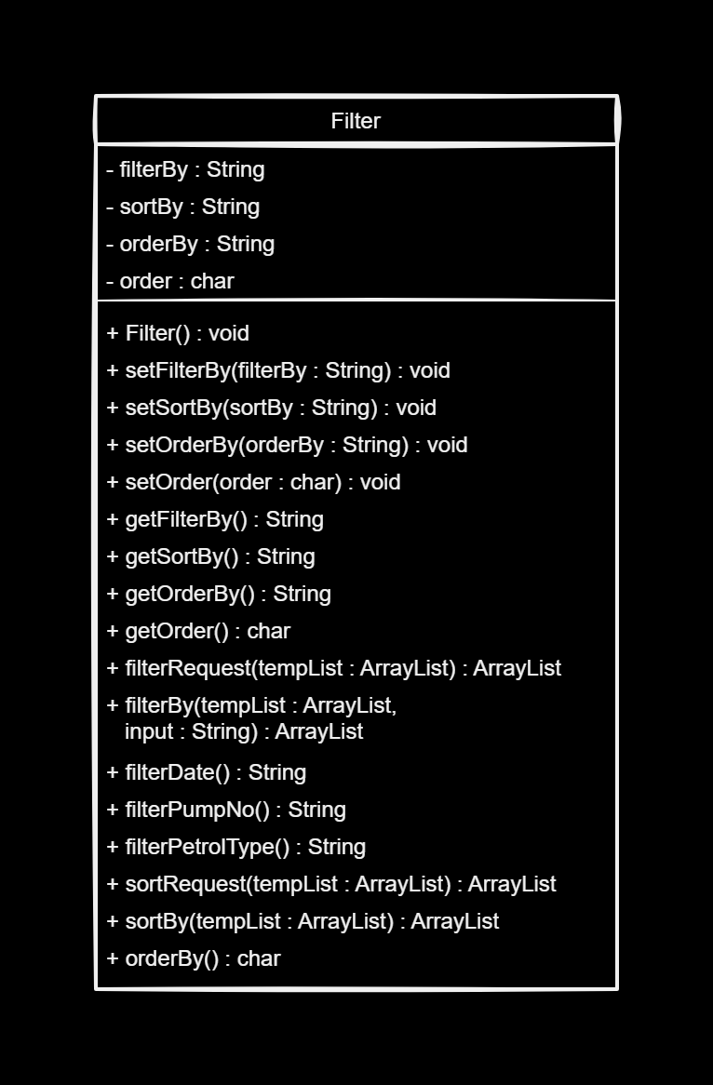
Filter
CLASS
> Handles the filtering/sorting/ordering processes of the requests log

Slide 29
DEMO

